Slide 1
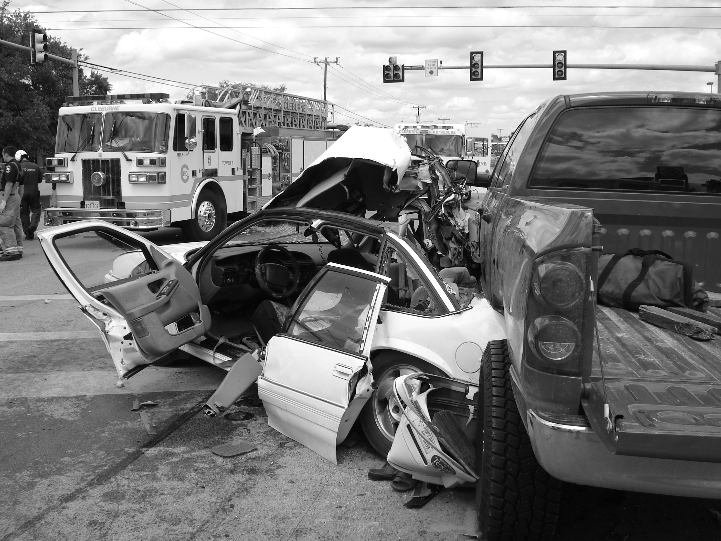
Capstone Project Car Accident Severity

Slide 2
Business Problem
Traffic collisions are in first place based on the number of deaths and injuries
Accidents occur for many reasons, including both technological and human factors
Is there a mechanism to predict the possibility of a car accident and its severity?
Goal :
identify and analyze the factors that cause traffic collisions
create a model that will predict the severity of car accidents

Slide 3
Data
Dataframe with accident severity of all collision types in Seattle, 2004-2020, available from IBM
Total: 194,673 entries and 37 features
After cleaning: 187,524 entries and 9 features
Target variable: SEVERITYCODE
Independent variables:
'WEATHER' - A description of the weather conditions during the time of the collision;
'ROADCOND' - The condition of the road during the collision;
'LIGHTCOND' - The light conditions during the collision.

Slide 4
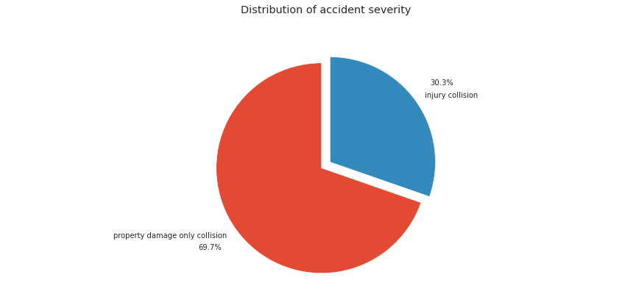
Accident severity distribution

Slide 5
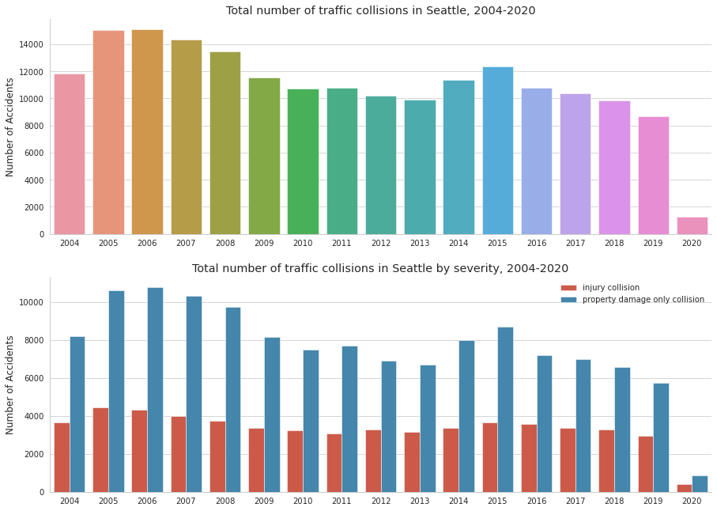
Annual amount of traffic accidents

Slide 6
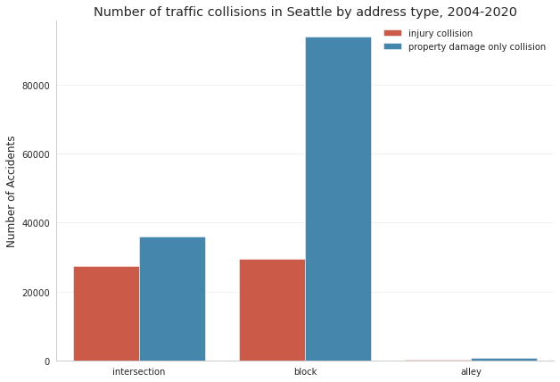
Address type of traffic accidents

Slide 7
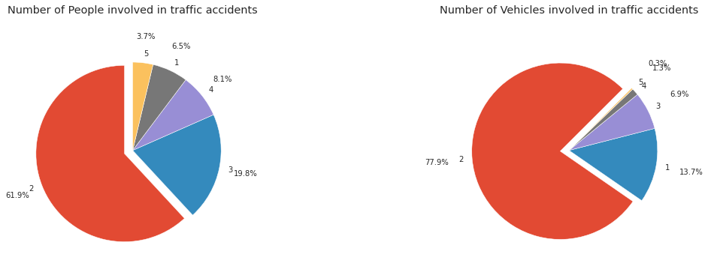
Number of People and Vehicles involved in traffic accidents

Slide 8
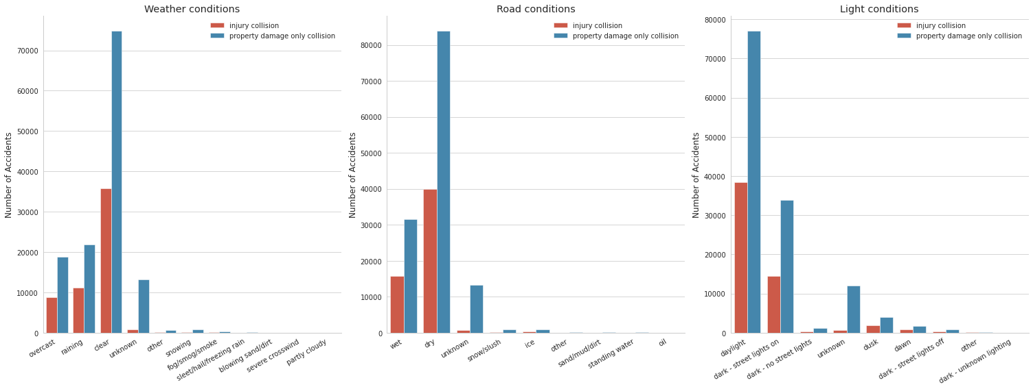
Weather, Road and Light conditions and Accident Severity

Slide 9
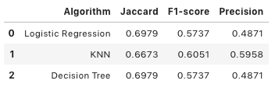
Classification algorithms
Jaccard’s score between 66.7% and 69.7%
F1-score is between 57.3% and 60.5%
Precision is between 48.7% and 59.5%

Slide 10
Conclusions
70% of accidents resulted in property damage while other 30% involved injuries.
Most of collisions happened either at the block or at the intersection.
In almost 62% of cases 2 people get in a car accident.
In nearly 78% 2 cars are affected by the collision.
Traffic accidents usually happen during daytime with clear weather and dry road condition.
All three algorithms showed similar results, while Logistic regression and Decision Tree showed better results in evaluating model accuracy.

